Slide 1

Introducing RSF
Antranig Basman,
CARET, University of Cambridge

Slide 2

Introducing RSF
What is it, Doctor??
RSF is a Java web programming framework, with roughly the
same scope as Sun’s JSF – it takes care of:
Locating and rendering views
Managing server-side and client-side state
Handling and abstracting the request cycle
It does NOT take care of:
What lies behind your data model (ORM)
Hibernate & co are highly developed solutions to this which
RSF aims to facilitate, not replace.

Slide 3
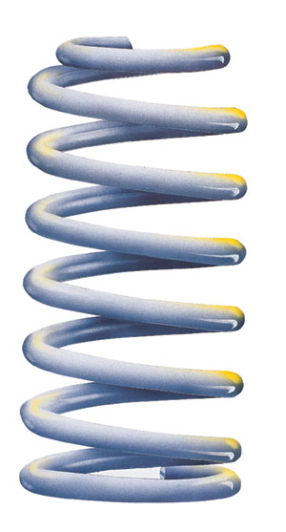
Introducing RSF
RSF is based on Spring
  Rather than just “integrating” with Spring, like other frameworks, RSF is built entirely from a set of Spring contexts.
RSF apps use pure HTML templating
  RSF templates really are pure (X)HTML, unlike those of most other frameworks.

Slide 4
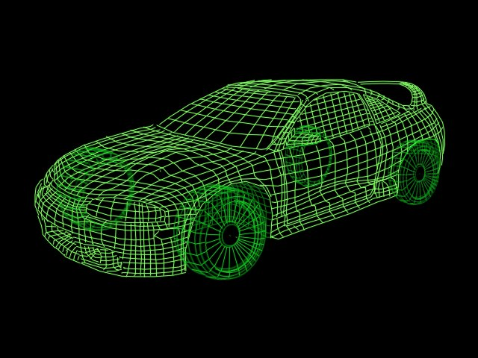
Who is RSF good for?
RSF is good for DESIGNERS:
  Design and UI teams spend a lot of effort researching user requirements, and produce “wireframe” (generally HTML mockups) for discussion and spec.
  In RSF, the “wireframe” *IS* the view definition.
  In fact the RSF tagging only enhances the wireframe value, since it merely labels semantically interesting parts of the view.
  Templates can be trivially swapped at request-time, making Accessibility/preferences work very easy.

Slide 5

Who is RSF good for?
RSF is good for Deployers/Admins:
  RSF has “zero server state” request handling inbuilt as the DEFAULT
  RSF apps will scale and cluster more easily through being free of bulky Session state
  Respect for HTTP idioms means caching and proxying are tractable
  Being based on Spring/IoC, RSF apps are very easy to configure and tweak for different environments

Slide 6
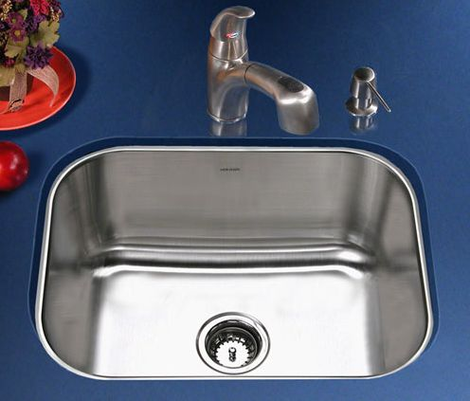
Who is RSF good for?
RSF is good for TESTERS:
  Not only app-wide IoC through Spring, but new request-scope IoC through RSAC provides an almost limitless number of test surfaces
  RSF has NO globally visible sources of state or “kitchen-sink” structures (e.g. FacesContext, ServletContext)
  In Servlets, for example, javax.Servlet dependence is cut off at the knees – only 5% of RSF code depends on Servlet, and none of yours does.
  Stubbing and mocking is extremely easy.

Slide 7
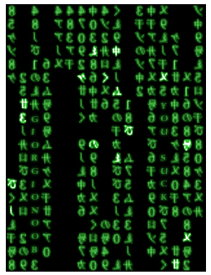
Who is RSF good for?
Last but certainly not least, RSF is good for CODERS:
  At the very least since all the previous groups of people will shout at you less!
  Despite its increased consideration for non-coders and non-Java, RSF is actually EASIER to work with than other frameworks
  You will write less code, and the code you write will make more sense
  Less “dull” work (wrapping, porting, writing DAOs etc.)

Slide 8

Who is RSF good for?
In fact, RSF is good for everyone
Except Sun

Slide 9
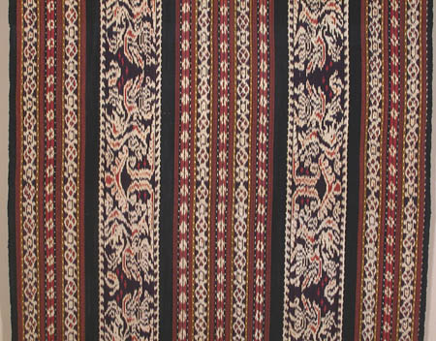
RSF Templating Basics
  The RSF templating engine, IKAT, is not like other HTML engines.
  At the template end, there is pure XML, annotated only by a single extra attribute, the rsf:id
  At the code end, there isn’t even a visible template!
  You just produce “components”
  Let’s see this in action

Slide 10
Tables in RSF
The Table component is the best component that isn’t in RSF
RSF tables are simply generated with a “for” loop
for (int i = 0; i < values.length; ++i) {
UIBranchContainer radiobranch =
UIBranchContainer.make(form, "animalrow:",
Integer.toString(i));
UISelectChoice.make(radiobranch, "animal", selectID, i);
UISelectLabel.make(radiobranch, "animallabel",
selectID, i);
UILink.make(radiobranch, "animalimage", URLs[i]);
}

Slide 11
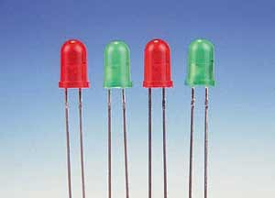
RSF Components
Unlike components in ALL other frameworks, RSF components have no “behaviour”
Just a set of fields
But still a technology-neutral representation of the contents of a view, like JSF-style components
Since they are bean-serialisable (like everything else in RSF – see later) they are amenable to being generated and manipulated by non-Java technologies (e.g. XML)

Slide 12
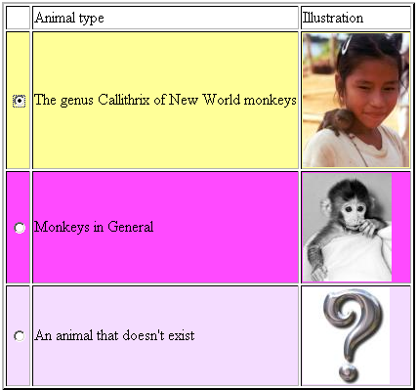
Resulting Table
A table with heterogeneous contents
In every “component” framework this would have required a custom component, and a special “data model”
In particular, this table is virtually impossible to achieve in JSF since it contains radio buttons in table rows (see IBM DeveloperWorks article)

Slide 13
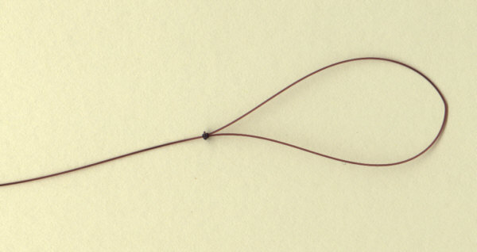

The IKAT algorithm
If there is no looping logic in the template,
and the producer is only calling component constructors, where is the loop?
The unique IKAT algorithm actually induces the loop logic from the component structure into replication of parts of the template
This is guided only by the assigned IDs, which are just Strings (rsf:id)
IKAT can perform both branching and
looping, which accounts for all possible
kinds of view generation logic

Slide 14

rsf:id
The only template attribute added to the target render (XML) language.
Only three interpretations:
  simple string denotes a (leaf) component peer, e.g. UIOutput
  string containing colon denotes a container peer (UIBranchContainer), which is a function call/branch point
  string containing equals sign denotes target of static rewrite rule (e.g. URL rewrite or other runtime binding)

Slide 15

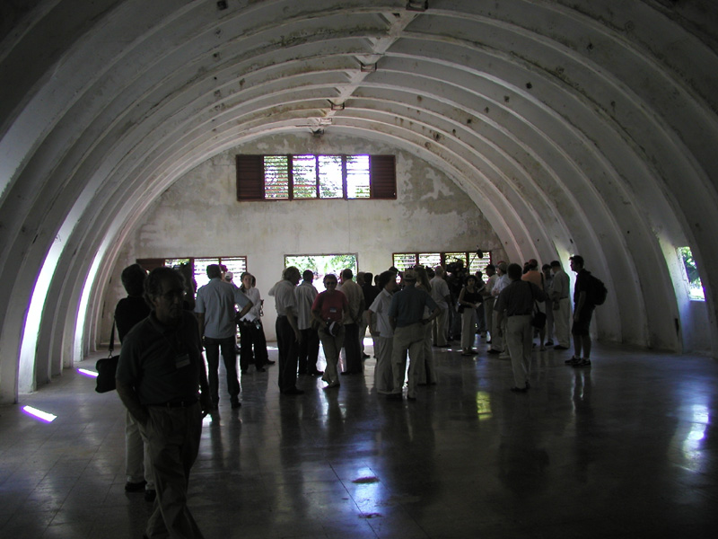
Back to the Monkeys –
Parachute Rendering
As well as inducing the replication logic from the component tree, IKAT also induces the rendering strategy from the template.
“Parachute” rendering because the
renderer inspects the situation
“on the ground”
Contrast to the “bunker mentality”
of JSF/Wicket etc. rendering.

Slide 16
Back to the Monkeys
Let’s go back to our “table” example
Simply by changing the HTML template, we can get this selection control rendered as an HTML <select> rather than a set of radio button <input> tags in table rows
This is impossible in any other framework

Slide 17
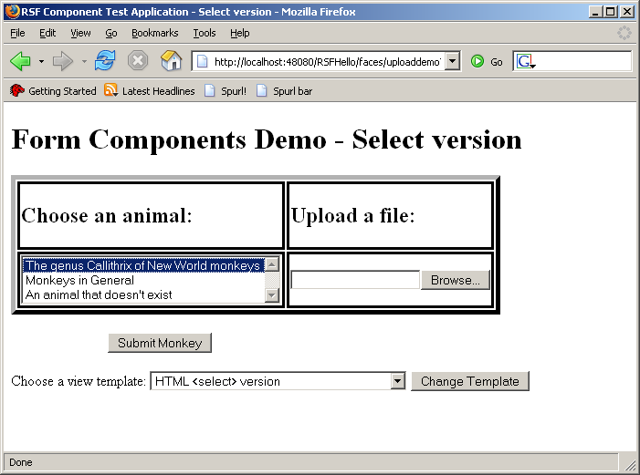

Slide 18

Monkey Choosing Demo
Try this demo online at ponder.org
Note that the template is dynamically selectable at runtime – you can view the template itself from a link from the page
Also demonstrates some other RSF components, such as file upload and HTTP GET forms (the latter is architecturally impossible in JSF)

Slide 19
The RSF Programming Model
RSF preserves all the “key value points” of JSF
  Abstract “component tree” isolates you from view technology
  EL bindings system isolates the data model from the view layer
  Abstract dispatching procedure isolates you from the hosting environment (Servlets, Portlets, Sakai – IChannel?)
But delivers on all its promises and more
  Free of “model” classes coupling you to the framework
  “Speak like a native” approach to HTML – anything is possible
  Output is GUARANTEED valid XML
  IoC throughout the framework means application fragility does not increase with size, testability &c.

Slide 20
Bindings in RSF - I
Making a “command link” is very easy.
UICommand deleteperm =
UICommand.make(permform, "delete-permission",
"#{permissionBean.delete}");
A control that when operated, will start an “Action” cycle, which will invoke the method binding – a zero-args method called “delete” on a bean called “permissionBean”
Very similar to JSF so far

Slide 21
Bindings in RSF - II
To a UICommand you may attach some number of “pure EL bindings”, which will cause a request-scope effect in the coming action cycle, before the method binding:
deleteperm.parameters.add(new UIELBinding(
"#{permissionBean.permissionID}", thisperm));
First argument is a “value binding” – property “permissionID” on bean “permissionBean”
The last argument may be any bean-serialisable object (preferably a small one)
Or it may be another value binding
This last is very very very powerful – provides “ahead-of-time” dynamic request-scope IoC

Slide 22
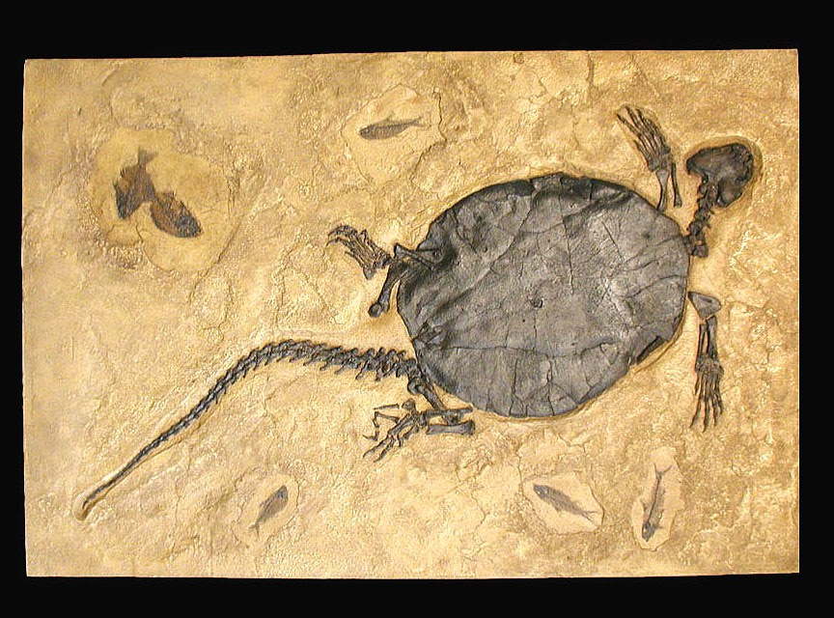
Bindings in RSF - III
Bindings may also be attached to a form as a whole, in which case they will submit whichever control is used.
Bindings are encoded on the client in a completely transparent form (“fossilized”)
Rather than a heap of base-64 encoded Java blobs, they are simple collections of Strings
Can be manipulated by Javascript and AJAX to create extremely dynamic UIs
However, the favoured approach for AJAX in RSF is probably AutoAJAX (coming next year?)

Slide 23

State in RSF - I
The key difference for folks coming from JSF is that RSF holds zero server state by default
Not only the component tree, but also the entire client model are thrown away at the end of every request
Server resource are precious, and the “time between requests” for a particular user is very large in server terms – why keep around something you could easily regenerate?
A better fit for HTTP which is a stateless protocol. RSF apps are very URL-response, and much more amenable to HTTP tools such as caches, proxies &c

Slide 24
State in RSF - II
When you *do* need server state in RSF, the framework makes it very easy to configure
E.g. Sakai RSF transparently uses the SakaiSession rather than the HttpSession without any extra config required.
In order to get maximum possible flexibility, RSF strongly encourages you to make all state bean-serialisable – just being Java-serialisable is not enough.
This also has benefits recognising the fact that Java is just a small part of a wider community of languages and technologies – RSF state is simply more portable.

Slide 25

TokenStateHolder
TokenStateHolder is a prime RSF “OLI”
Preservation strategy talks to a “backend” form of storage which accepts named beans of an agreed level of serializability. Some examples (not all implemented yet!) are
  InMemoryTokenStateHolder
  InHttpSessionTokenStateHolder
  InClusterTokenStateHolder
  InURLPreservationStrategy
  InFormStateHolder
  InCookieStateHolder
Server-side TokenStateHolders will cache for some selected time or until selected condition. For example, Flow scope TSH will be long-lived (like Session), whereas “Bandgap” TSH might last minutes or seconds.

Slide 26
State in RSF
The cornerstone of RSF is that application state should be as mobile as possible
Being Java-serialisable is not enough, RSF state should also be bean-serialisable (e.g. as XML)
This recognises the fact that Java is just a small part of a wider community of languages and technologies
This is most obviously valuable when dealing with the client (think Javascript and AJAX)

Slide 27
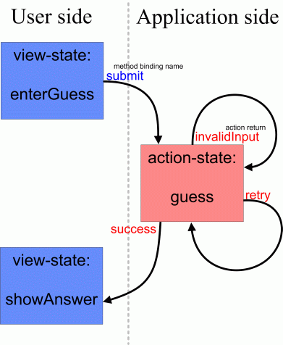
“Flows” in RSF
RSF offers a rich set of alternatives for defining flows, i.e. scopes for conversational state between client and server.
  Firstly, the Flow “Lite” package modelled on (and file-compatible with) Spring Web Flow

Slide 28

“Informal” Flows
Also, radical and slick new “Informal Flows” system allows flows to be built up view by view, without the need for a central definition file (or any XML)
“Informal Flows” reduces to the same syntax as JSF NavigationCases if you omit the last parameter.
public List reportNavigationCases() {
List togo = new ArrayList();
togo.add(new NavigationCase(null, new
SimpleViewParameters(UploadResultsProducer.VIEW_ID),
ARIResult.FLOW_ONESTEP));
return togo;
}

Slide 29
Request-scope IoC I
Request-scope IoC within RSF is operated by a lightweight Spring clone, RSAC
RSAC is file-compatible with Spring (although with slightly reduced functionality), but is nearly 100x faster
Request-scope IoC is a crucial part of RSF’s flexibility
Request-scope has made it into Spring 2.0 at the last moment, but the implementation is be too slow to be useful (probably ever)

Slide 30
Request-scope IoC II
A good example of RSAC use is in the delivery of Locales
In Sakai, the correct Locale depends on a number of request-scope sources (current user, current request, current session)
Within RSF, as well as automatic use of the correct Locale for resolving Messages, you can also arrange to have the correct Locale injected practically anywhere in your app (for example for rendering Dates correctly)
Unfortunately since Locale is final and has no interface (another JDK blunder) this injection has to be done using an intermediary LocaleGetter
public void setLocaleGetter(LocaleGetter localegetter) {
this.localegetter = localegetter;
}

Slide 31
Case Study: The TaskList app
The TaskList app was developed as part of the Sakai Programmers’ Café workshop, to demonstrate Sakai tool development
Original JSF version was rewritten in RSF
A major API and implementation, as well as the JSP could be abolished, as well as the handling bean being slashed by more than 50%
The resulting app is easier to understand and maintain, and also much more efficient since it makes no long-term use of server state in sessions.

Slide 32
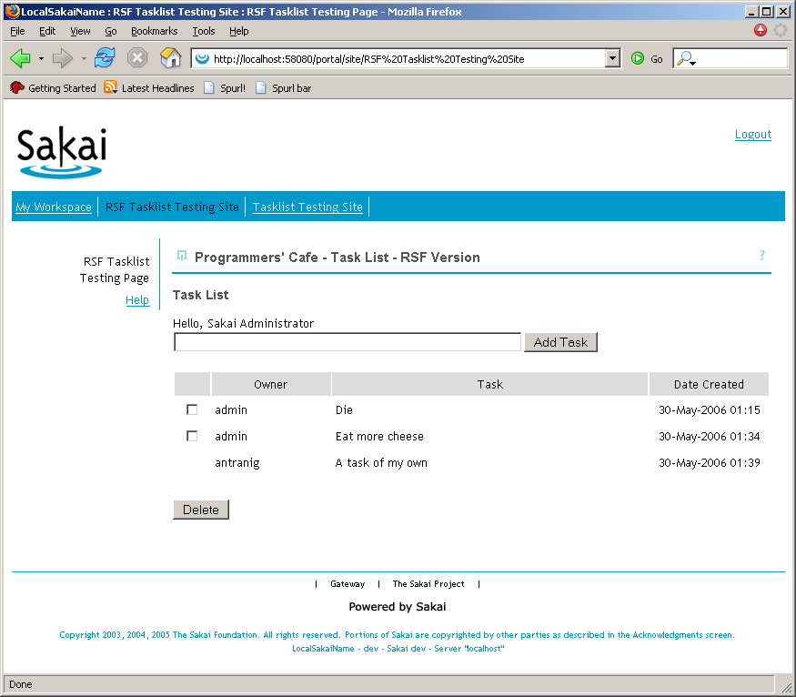

Slide 33
Contrasts with JSF version
Since the RSF ViewProducer is a normal Spring bean, there is no need for the special “Service” API which was only needed to inject services conveniently into JSF
The iteration logic which *was* in the JSF “bean” has now moved into the ViewProducer
Instead of copying “representations” of the object into a framework-dependent “magic box” where it is queried later, in RSF you simply render a component on the spot for each Task in the list.
The loss of the JSP sheds masses of complexity and obscurity – use normal Java code rather than having to package it in “taglibs”
App is now highly portable and trivial to reskin

Slide 34
RSF Timeline
July 2005 | “JSFUtil” destroyed
September 2005 | RSF 0.5 demonstrated at Developers’ Meeting, Cambridge – UIOutput and UIInput only
December 2005 | RSF 0.6 – UIType system stabilised, Flow “Lite”
April 2006 | RSF 0.6.1 – Reformed build system, Hibernate support, full XML component serialisability, UISelect – First public release, JIRA, forums
May 2006 | RSF 0.6.3 – Complete set of HTML components, non-HTML ContentTypes (XUL, RSS, AJAX), JSR-168
June 2006 | RSF 0.6.4 – Support for Sakai 2.2, Hibernate 3. Last 0.6 release
August 2006 | RSF 0.7 – Multi-file templates, custom components, “Renderer reform”
End 2006 | RSF 1.0 – General shakedown, acceptance testing, load testing, fine-grained error and validation system
The future | RSF 2.0 – AutoAJAX, Differential IKAT and the Bean Invalidation Model…. leading to “Snooze”

Slide 35
Some pointless Metrics
Code Size:
  RSF is by far the smallest (reasonably complete) web framework out there
  As of 0.6.3, 12,000 lines of code, next competitor is Wicket at 76,000
  JSF (1.1) is more than 10x the size at 140,000
Speed
  IKAT is extremely fast, and piles out data about as fast it can be read from disk – a limiting factor is XML-encoding(!)
  RSAC adds less than 1ms to request processing time

Slide 36
Conclusion
You want to use RSF to develop your next app.

Slide 37





Acknowledgements
The CARET Team
Raymond Chan
Andrew Thornton
Dan Sheppard
Ian Boston
and
John Norman

Slide 38
And Special Thanks To…
Steve Githens,
    First User

